Slide 1
Lab. 14
Logic Design Lab.
Spring 2014
Prof. Naehyuck Chang
(naehyuck@snu.ac.kr)
TA. Taeyoung Kim
(tykim@iris.snu.ac.kr)
TA. Duseok Kang
(kangds0829@iris.snu.ac.kr)

Slide 2
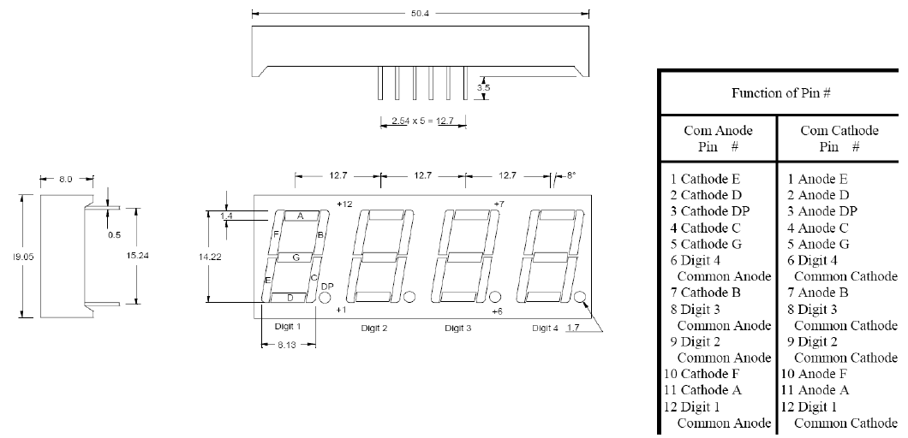
Dynamic Display
4-bit 7-segment Display
Way to control an array of LEDs.
We use Clock (oscillator) to light LEDs of an array in rotation.

Slide 3
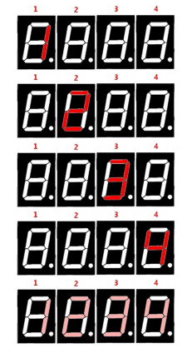
Practice
Implement Control Circuit which prints on 4-bit 7-segment LED
Implement Control Circuit which prints ‘1234’ on 4-bit 7-segment LED.
You must implement the circuit at ‘bread board’.
You can use MUXs or Counters and 7-segment decoder.
Write Result Report about today’s practice. Maximum 3 pages (Due : May, 26th)

Slide 4
Preliminary Report
Requirements
Either in Korean or in English
No cover page
At least 1 page
Write your group, student number, name
Study CPLD
What is it / Compare it with FPGA
Using XC9536XL and Xilinx ISE, how to program the device? Explain each step in detail
What is a .jed file? What is the difference between a .bit file?
Implement a “2:4 Decoder” with Xilinx ISE
Write VHDL or Verilog code for the decoder
Simulate and verify
Due : May, 21th

